Slide 1
Approach
Frequency range: 0Hz – 360Hz
Voltage range: 1e-3V – 1V

Slide 2
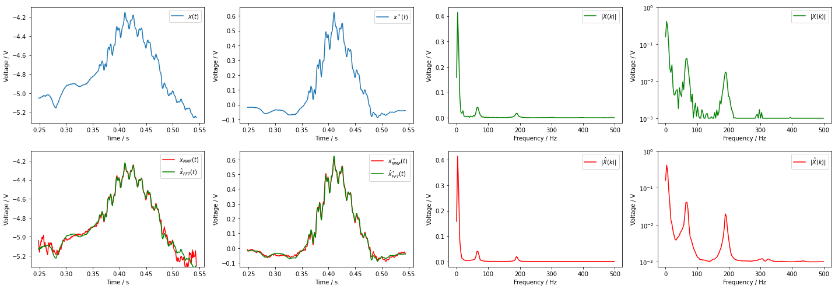
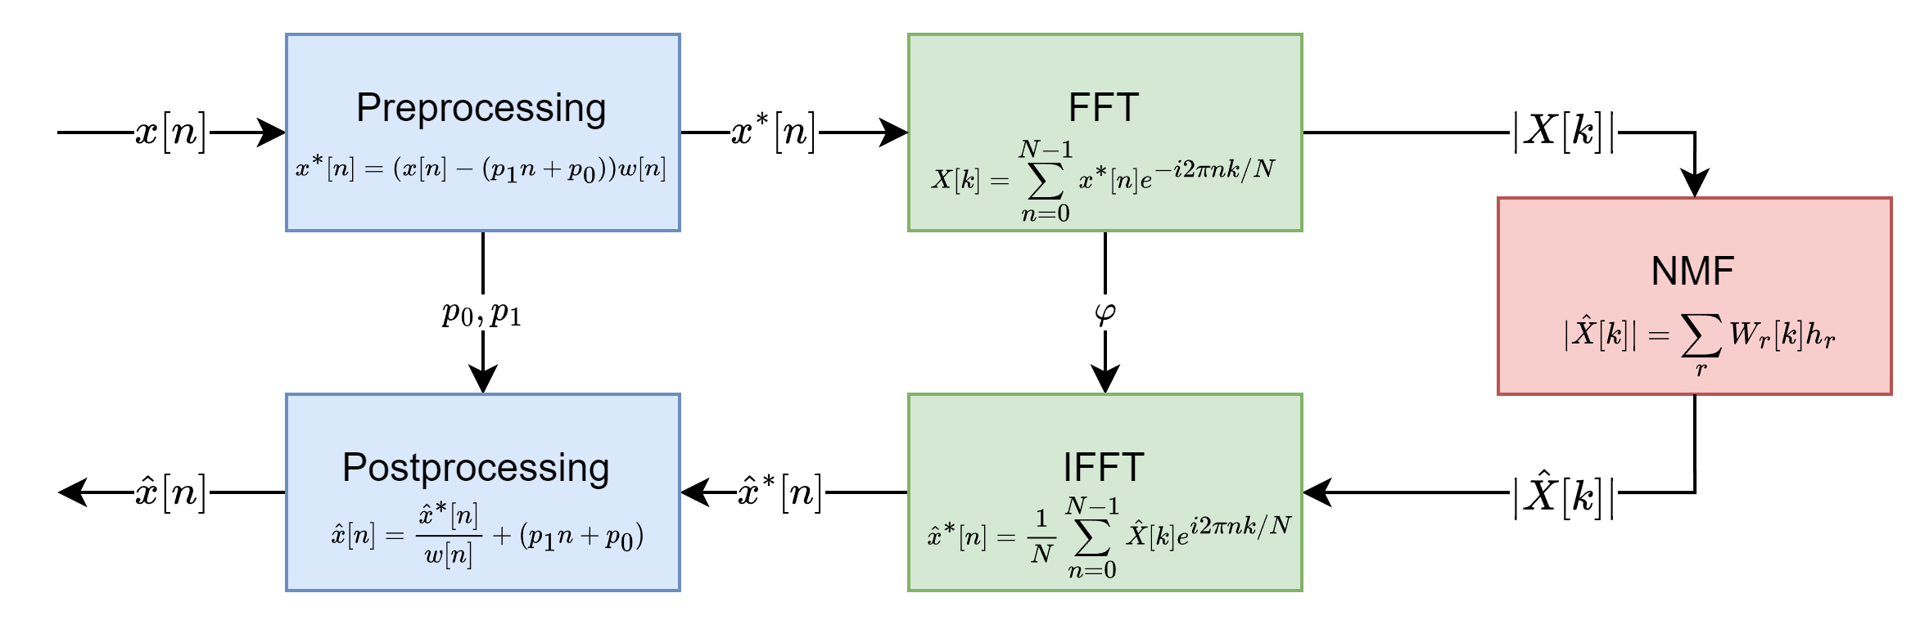
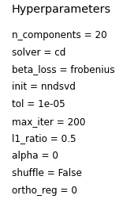
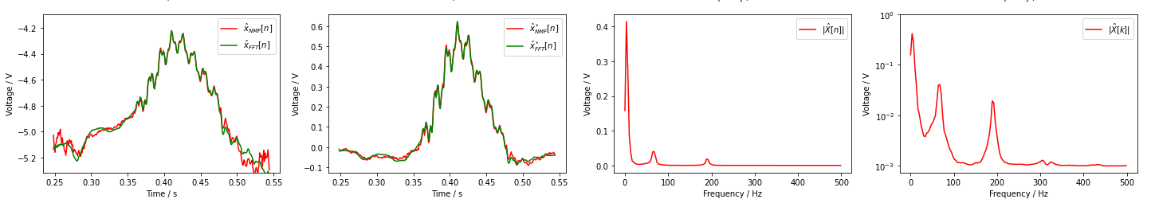

Slide 3
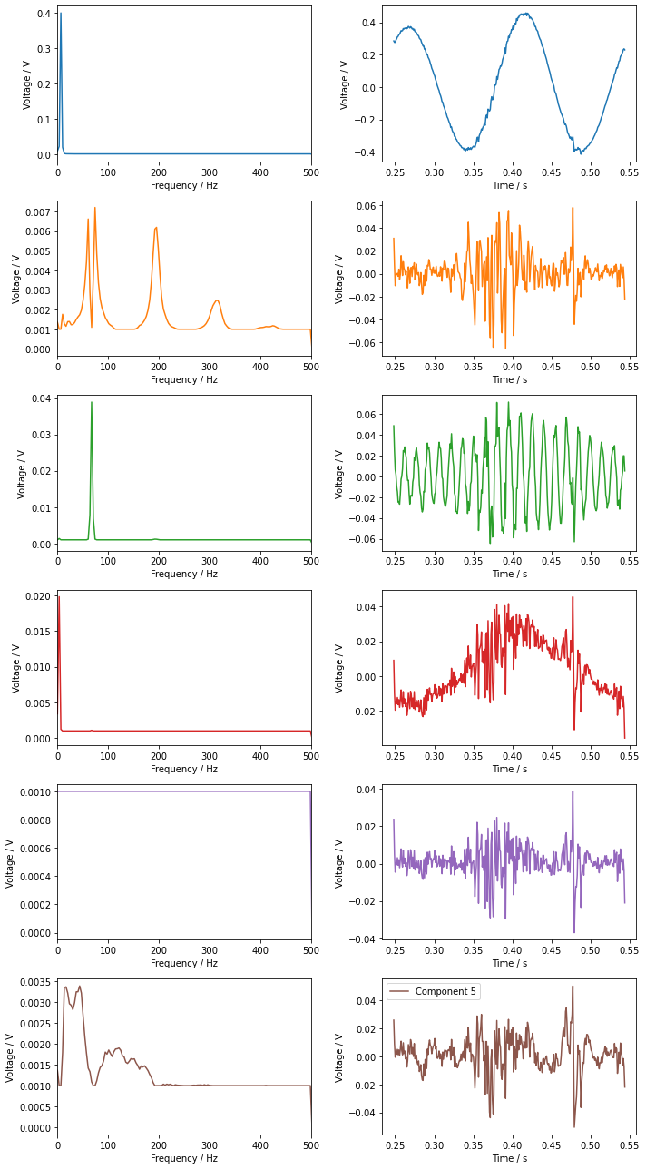
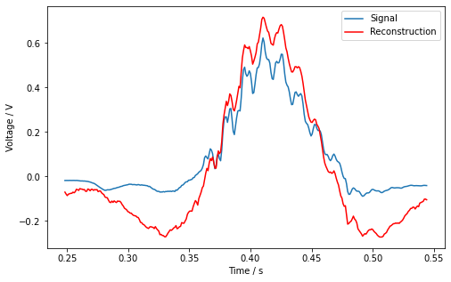
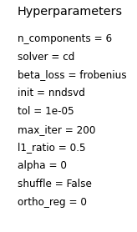

Slide 4
Anomaly detection
Frequency range: 0Hz – 500Hz
Voltage range: 1e-3V – 1V

Slide 5
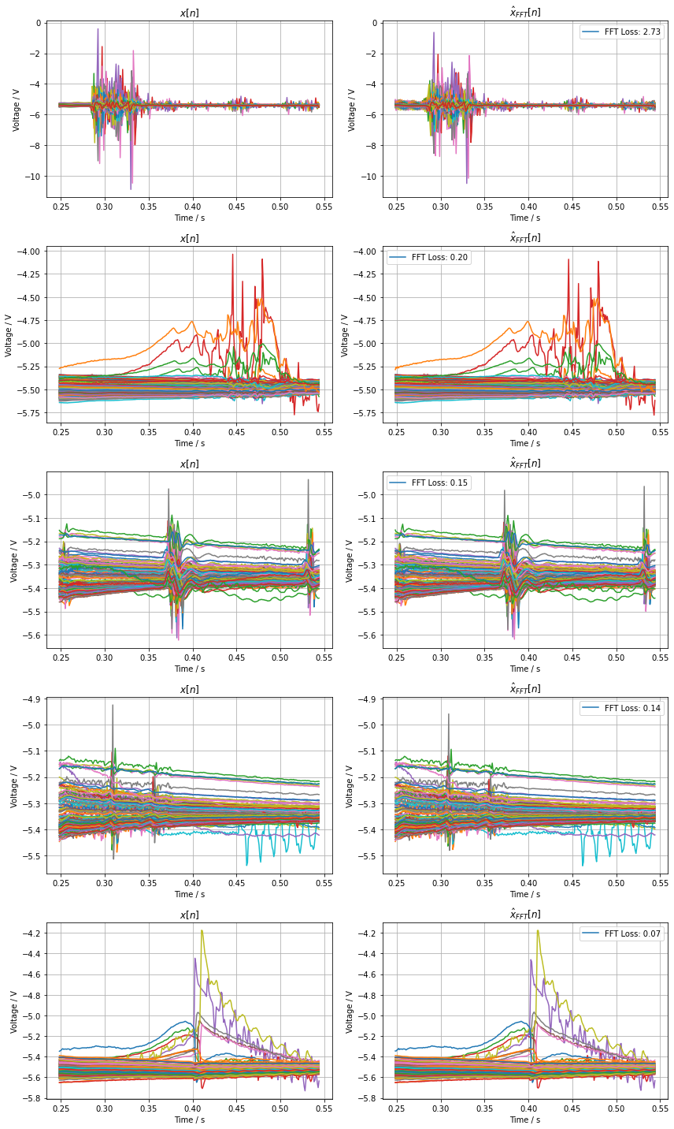
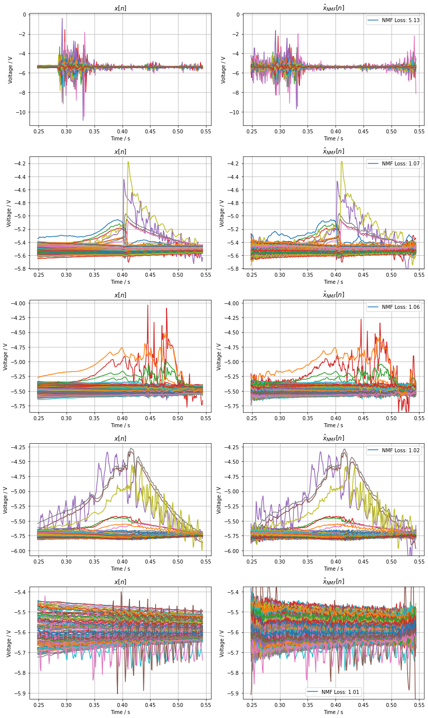
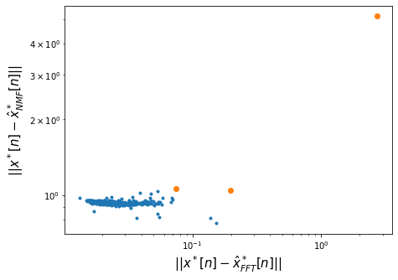

Slide 6
Component interpretation

Slide 7
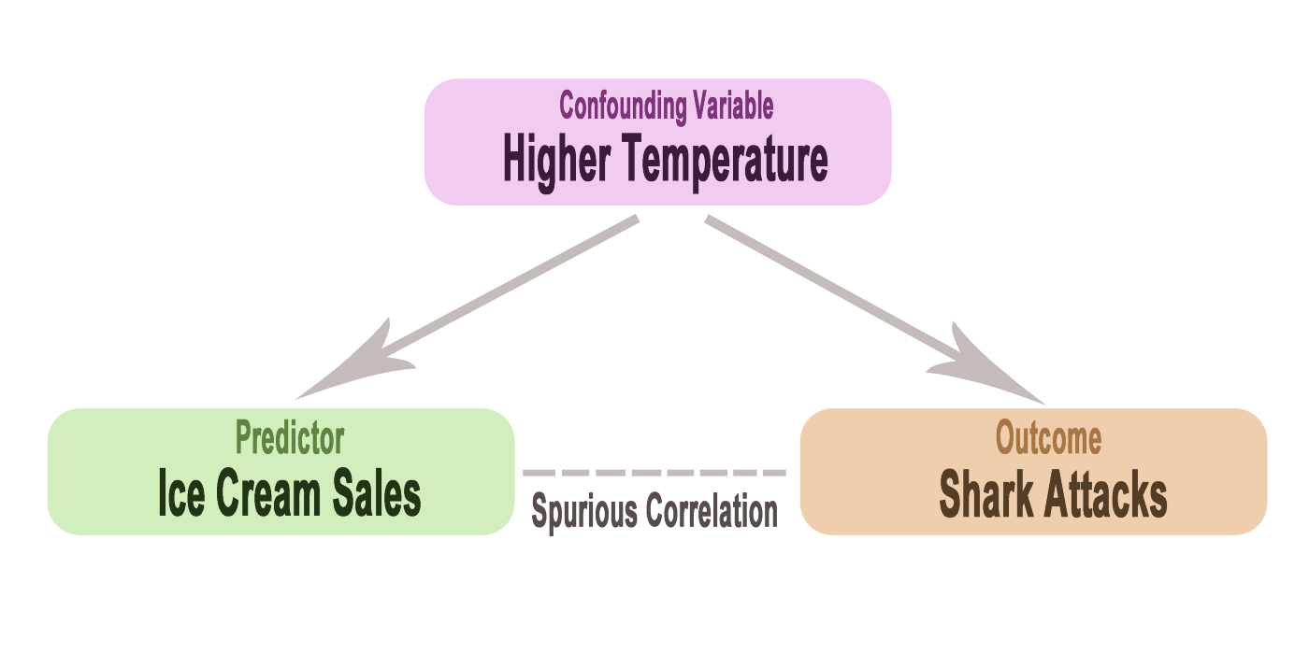
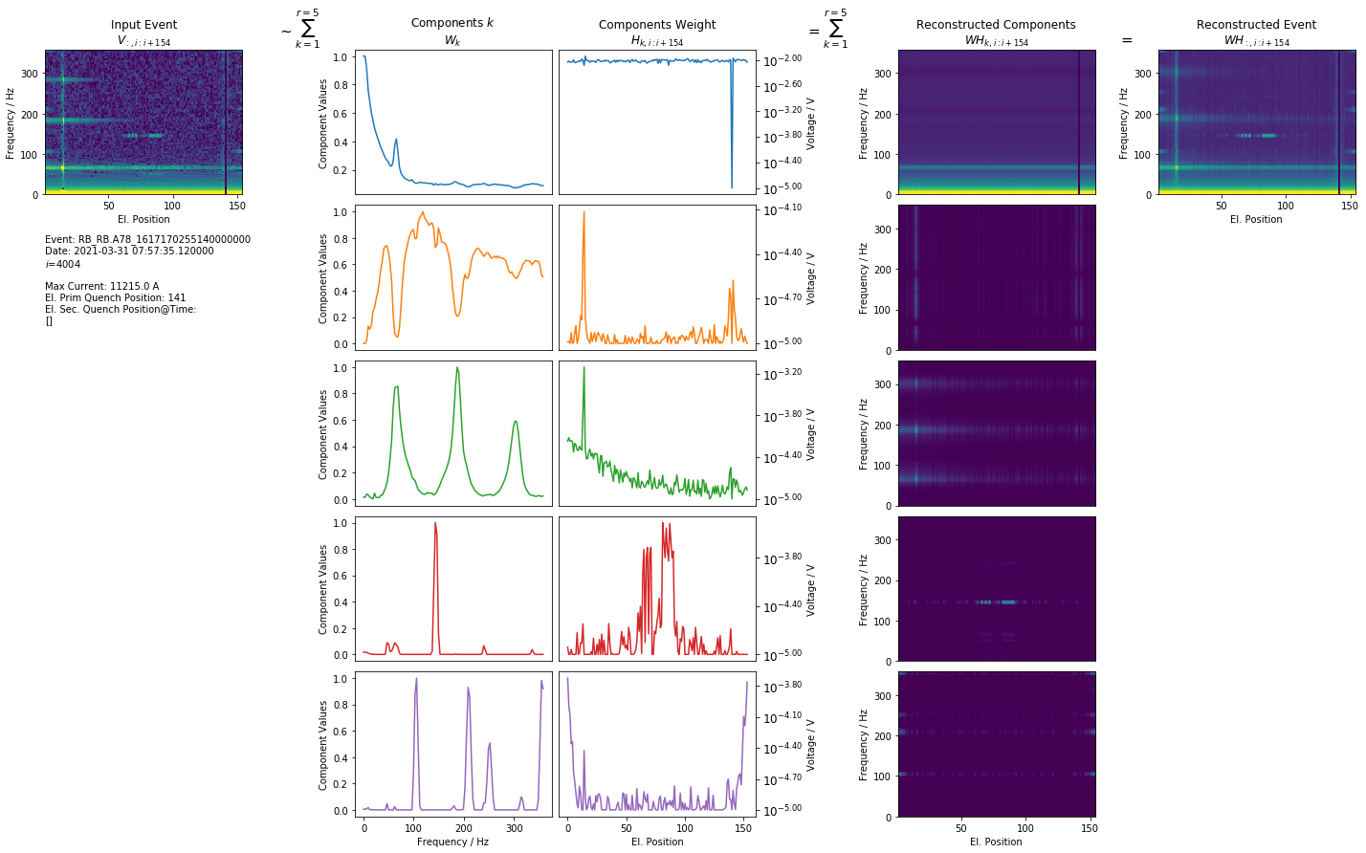
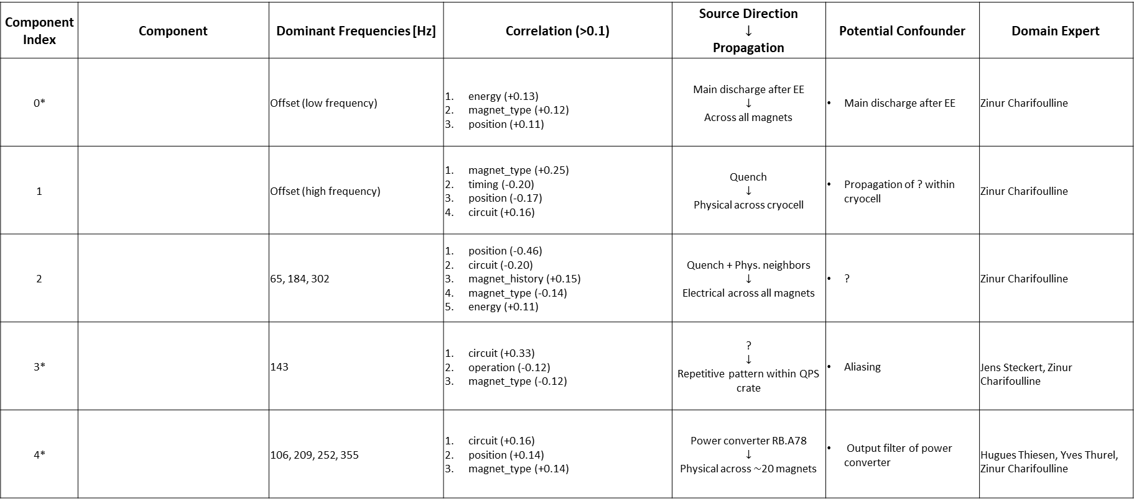
Component Index | Component | Dominant Frequencies [Hz] | Correlation (>0.1) | Source Direction $$↓$$ Propagation | Potential Confounder | Domain Expert
0* |  | Offset (low frequency) | energy (+0.13) magnet_type (+0.12) position (+0.11) | Main discharge after EE $$↓$$ Across all magnets | Main discharge after EE | Zinur Charifoulline
1 |  | Offset (high frequency) | magnet_type (+0.25) timing (-0.20) position (-0.17) circuit (+0.16) | Quench $$↓$$ Physical across cryocell | Propagation of ? within cryocell | Zinur Charifoulline
2 |  | 65, 184, 302 | position (-0.46) circuit (-0.20) magnet_history (+0.15) magnet_type (-0.14) energy (+0.11) | Quench + Phys. neighbors $$↓$$ Electrical across all magnets | ? | Zinur Charifoulline
3* |  | 143 | circuit (+0.33) operation (-0.12) magnet_type (-0.12) | ? $$↓$$ Repetitive pattern within QPS crate | Aliasing | Jens Steckert, Zinur Charifoulline
4* |  | 106, 209, 252, 355 | circuit (+0.16) position (+0.14) magnet_type (+0.14) | Power converter RB.A78 $$↓$$ Physical across $\sim$20 magnets | Output filter of power converter | Hugues Thiesen, Yves Thurel, Zinur Charifoulline

Slide 8
Next Steps
Improve Process
Study effect of Assumptions
How to evaluate?
Which parameters to vary?

Slide 9
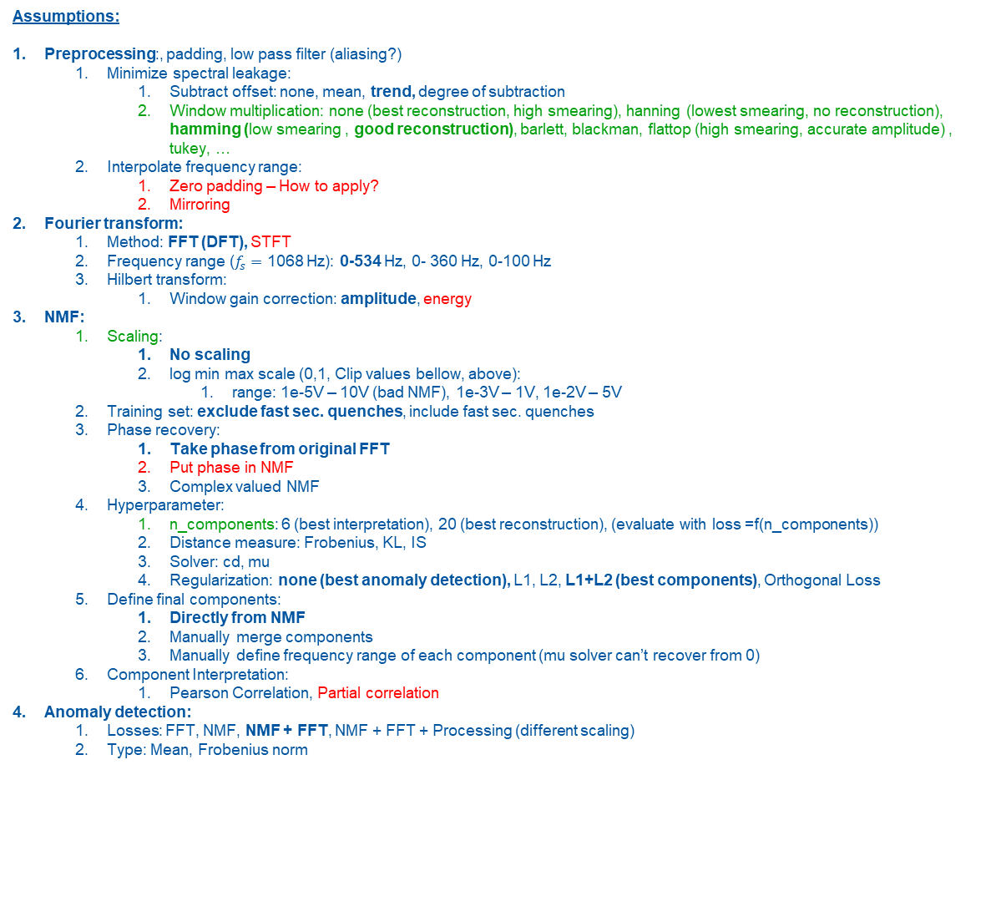
Assumptions:
Preprocessing:, padding, low pass filter (aliasing?)
Minimize spectral leakage:
Subtract offset: none, mean, trend, degree of subtraction
Window multiplication: none (best reconstruction, high smearing), hanning (lowest smearing, no reconstruction), hamming (low smearing , good reconstruction), barlett, blackman, flattop (high smearing, accurate amplitude) , tukey, …
Interpolate frequency range:
Zero padding – How to apply?
Mirroring
Fourier transform:
Method: FFT (DFT), STFT
Frequency range ($f_{s}=$ 1068 Hz): 0-534 Hz, 0- 360 Hz, 0-100 Hz
Hilbert transform:
Window gain correction: amplitude, energy
NMF:
Scaling:
No scaling
log min max scale (0,1, Clip values bellow, above):
range: 1e-5V – 10V (bad NMF), 1e-3V – 1V, 1e-2V – 5V
Training set: exclude fast sec. quenches, include fast sec. quenches
Phase recovery:
Take phase from original FFT
Put phase in NMF
Complex valued NMF
Hyperparameter:
n_components: 6 (best interpretation), 20 (best reconstruction), (evaluate with loss =f(n_components))
Distance measure: Frobenius, KL, IS
Solver: cd, mu
Regularization: none (best anomaly detection), L1, L2, L1+L2 (best components), Orthogonal Loss
Define final components:
Directly from NMF
Manually merge components
Manually define frequency range of each component (mu solver can’t recover from 0)
Component Interpretation:
Pearson Correlation, Partial correlation
Anomaly detection:
Losses: FFT, NMF, NMF + FFT, NMF + FFT + Processing (different scaling)
Type: Mean, Frobenius norm

